Slide 1
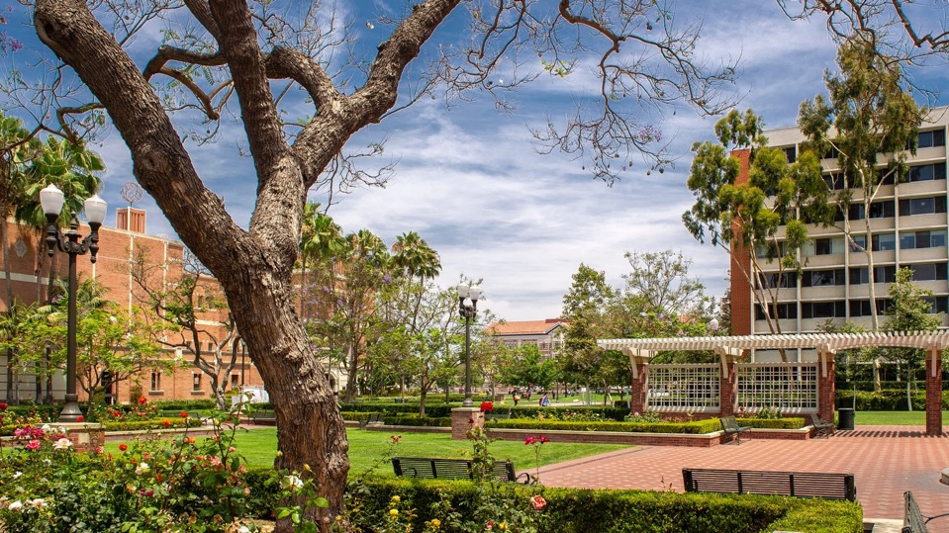

Research strategy & development
Jordan Locy • Senior Grant Writer
Navigating Research & Scholarship at USC • Federal & Multidisciplinary Opportunities
August 18th 2023

Slide 2
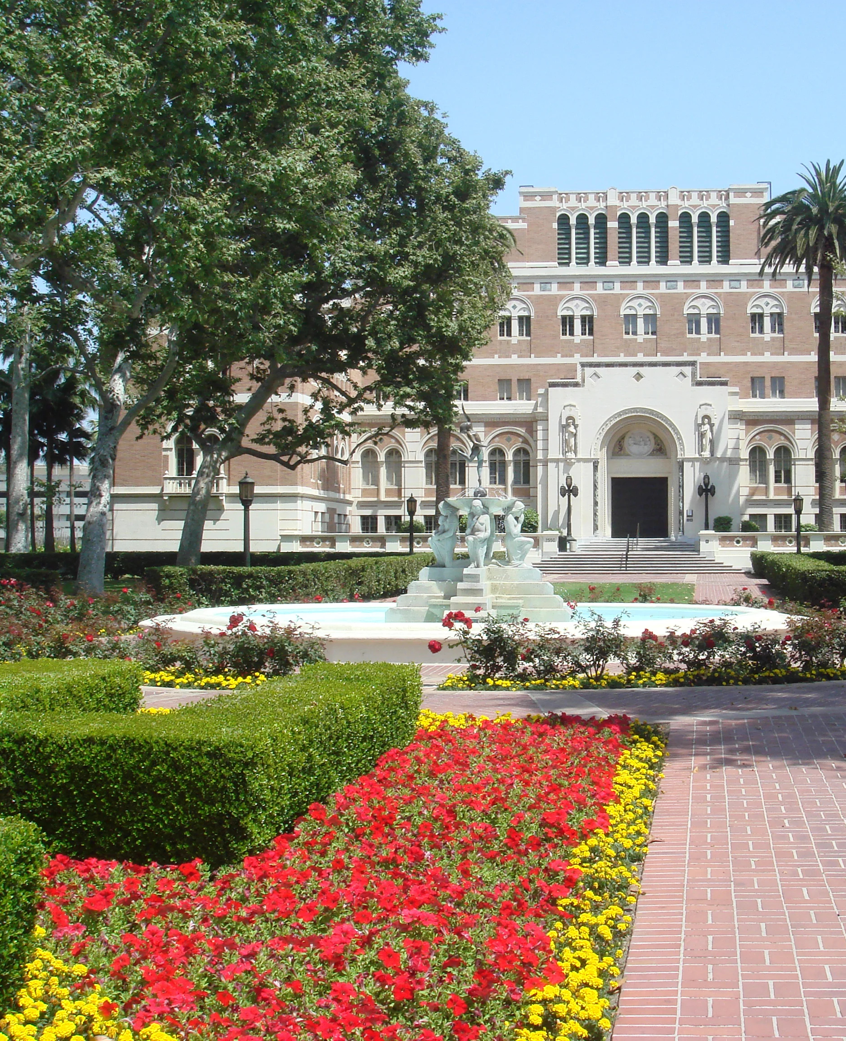

1
Overview
2
contents
Resources
3
Contact

Slide 3


overview
USC Research Strategy and Development (RSD) is a service resource for USC that strategically pursues competitive federal funding opportunities, with a focus on large, multidisciplinary research endeavors
RSD staff located in Los Angeles and Washington DC
Work with faculty from all USC schools
RSD’s primary focus is on complex proposals (e.g., NIH centers, DoD MURIs, NSF STCs, training grants, etc.), however, we do assist with smaller proposals from individual labs
Since 2006, RSD has worked with over 500+ USC PIs and contributed to the submission of over 1,000 proposals, of which 300 were funded for a total of over $850 million
RSD’s primary targets include federal agencies such as:
Notes:
https://asm.org/Articles/Policy/2020/March/ASM-Supports-CARES-Act-to-Combat-COVID-19

Slide 4

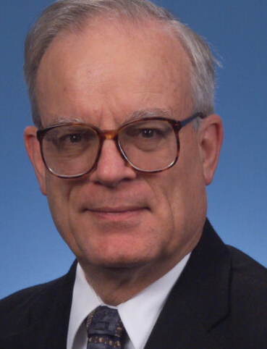
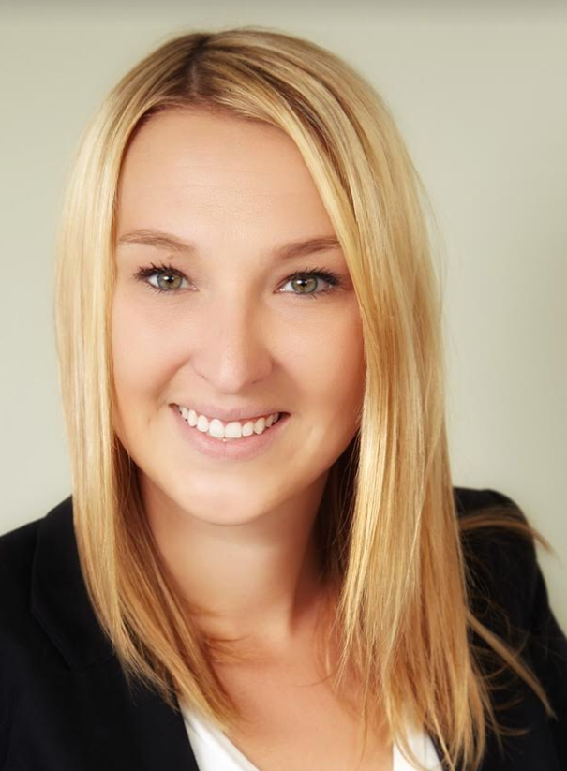
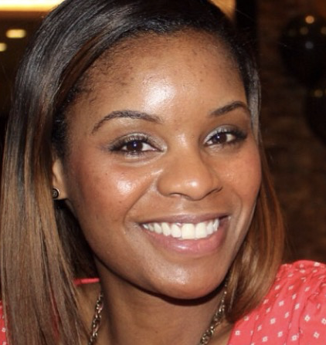
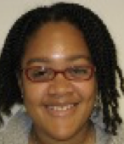
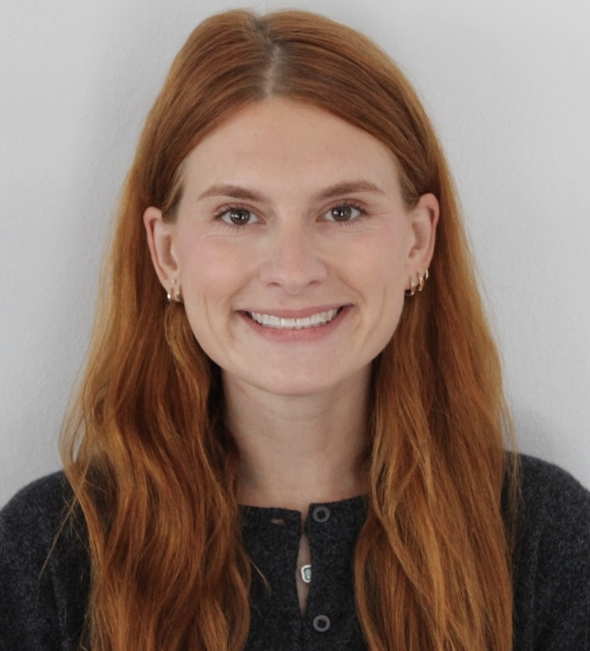
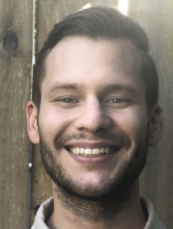
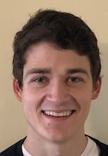
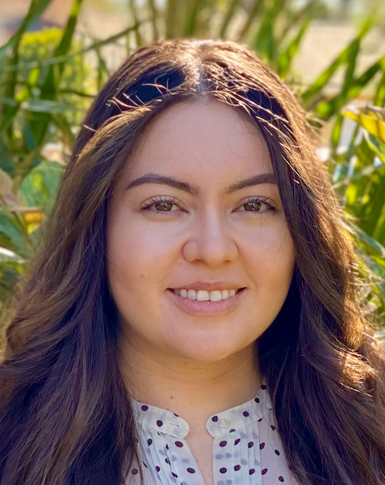
Associate Vice President
Research Strategy & Innovation
Steven Moldin
OVERVIEW
Director
Physical Sciences
James Murday
Program Manager
Robyn Hejmej
Director
National Security
Allan Olson
Project Specialist
Amber Gray
Project Specialist
Ashley Gordon
Senior Grant
Writer
Jordan Locy
Grant Writer
Aaron Nordman
Grant Writer
Ethan Bochicchio
Grant Writer
Helen Immerso

Slide 5
RESOURCES
Office staff are available to provide multiple support services, including:
  Notice of Funding Opportunities
    Monitoring and personalized distribution of federal funding opportunities
  Federal Outreach
    Identifying program officials and facilitating connections – meeting space in Washington, DC in the new USC building
  Junior Faculty Outreach
    Annual workshop and individualized consultations for junior faculty, hosted by Jim Murday, to explore early career opportunities
  Personalized Federal Funding Strategy Sessions
    Individual strategy sessions to discuss research interests and identify funding pathways
  Faculty Collaborations
    RSD staff can assist with identifying potential collaborators both from within USC as well as from external institutions

Slide 6
RESOURCES
National Security Constituency
  Support for proposals being submitted for funding by the national security community – subject matter expertise
Analytics
  Staff can conduct analysis of federal funding patterns and previously funded proposals, in order to maximize chances of success
Support for Proposal Development
  Availability of numerous proposal development services, including team building, proposal planning and coordination, grant writing, budget preparation, administrative and logistic support, and proposal submission support
Graphic Design
  Wide range of graphic design support, including the development of organizational and conceptual figures

Slide 7
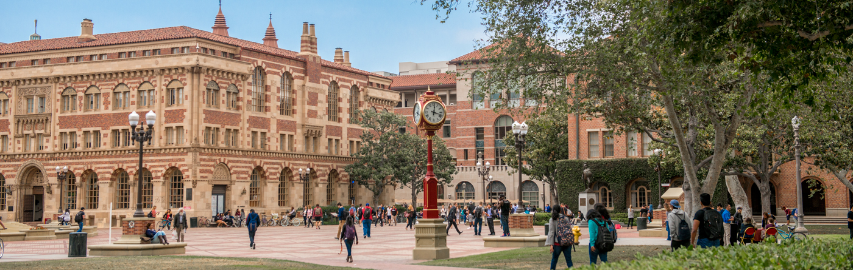
Contact us!
For more information on RSD resources, office capabilities, and personnel, visit rsd.usc.edu
For proposal support or further inquiries, contact Jordan Locy at locy@usc.edu

