Slide 1


Southern California Clinical and Translational Science Institute
Navigating the University Presentation:
August 18, 2023
Michele D. Kipke, Ph.D.
Co-Director of SC CTSI
AVP Strategic Health Alliances

Slide 2
SC CTSI at a Glance
Overarching Theme: Diversity
  Communities: Diverse communities of LA
  Clinical Settings: Keck, CHLA, LACDHS
  Academic Disciplines: Faculty from 9 USC schools
Scientific Focus: T2-T4 Research
Primary Partners: USC, CHLA, LA County Department of Health Services - and many community organizations
Clinical Trials
Health Services
Community
Training

Slide 3
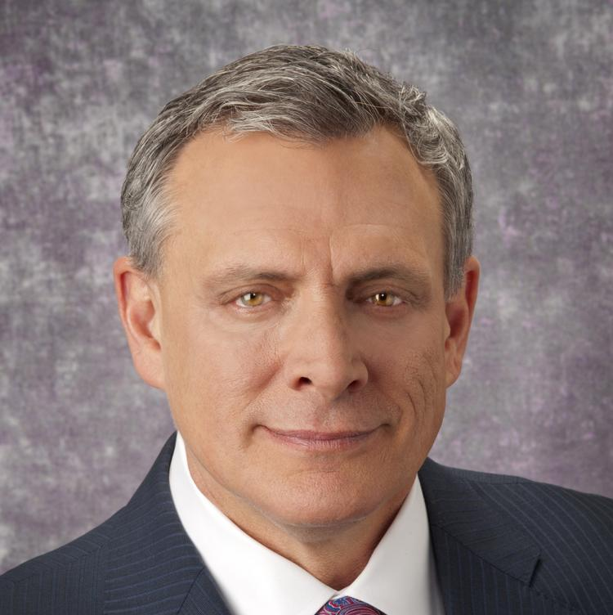
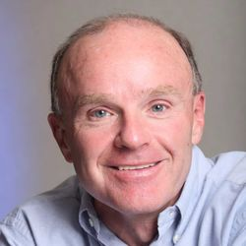
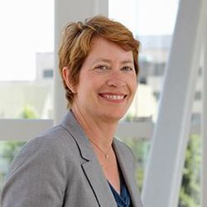
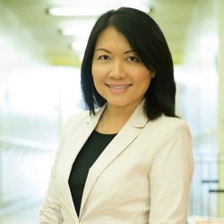
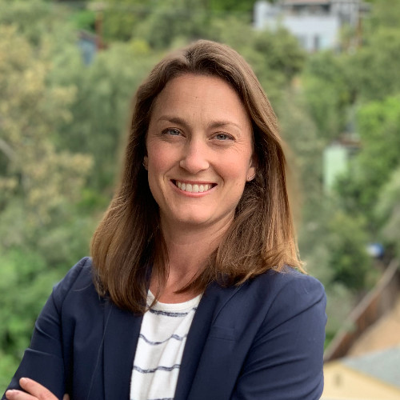
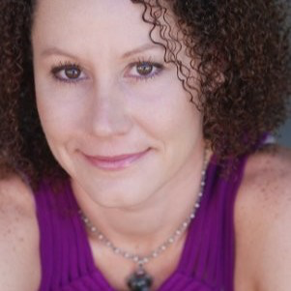
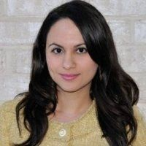
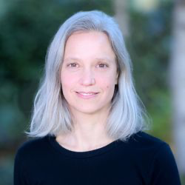
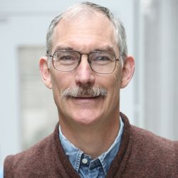
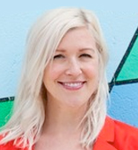
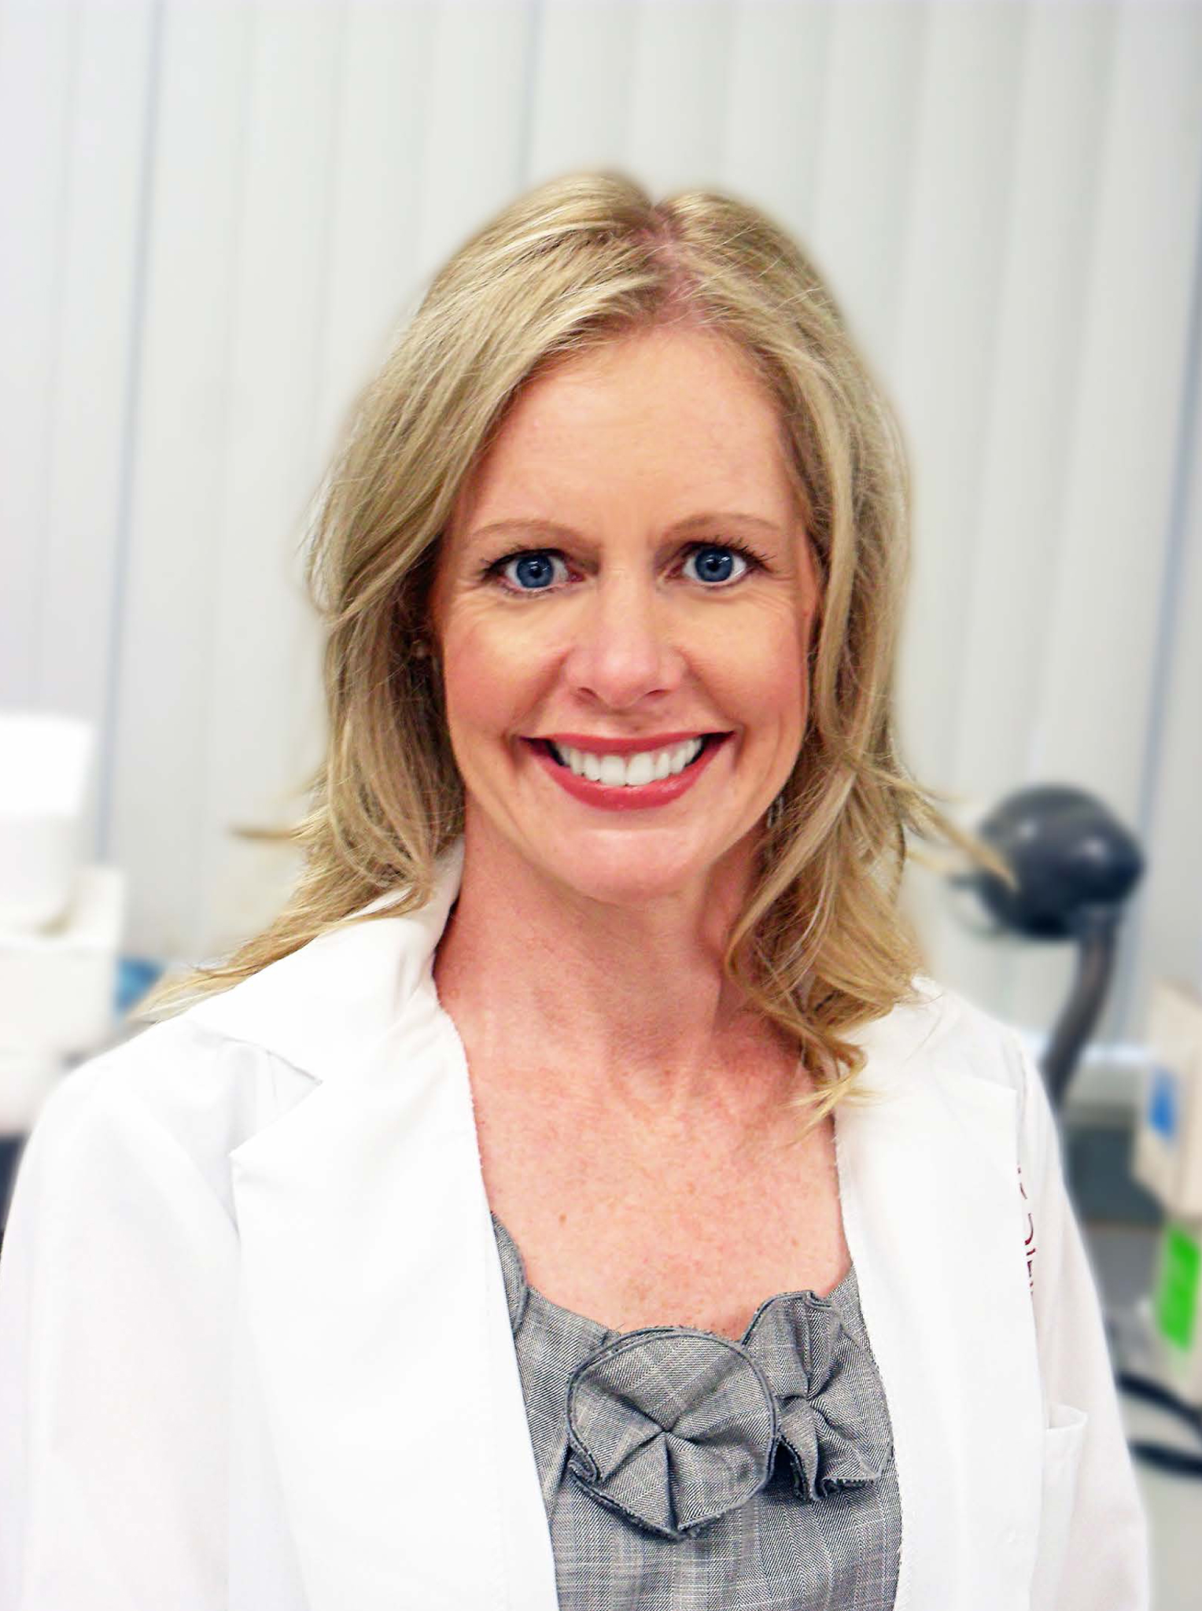
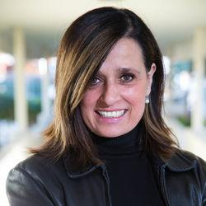
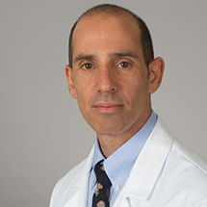

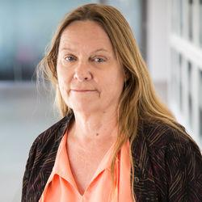
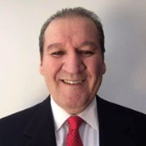
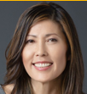
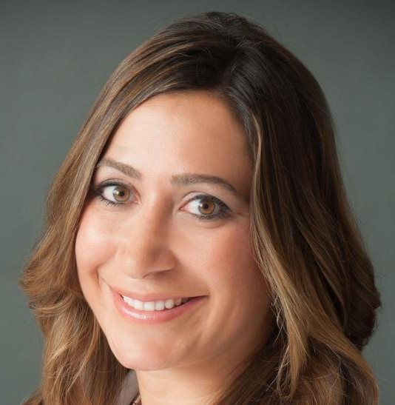

SVP Health Affairs
Steven Shapiro
SC CTSI
People and Programs
EXTERNAL ADVISORY COMMITTEE
Directors
Team
INTERNAL ADVISORY BOARD
Institute Director
Thomas Buchanan
Institute Co-Director
Michele Kipke
Operations & Finance
Quinnie Le
Strategy
Allison Orechwa
Communications
Nicki Apaydin
CHLA
Tamara SImon
Evaluation
Nicky Maccalla
Clinical Research Support
Community Engagement
Research Development
Workforce Development
Executive
Team
TBN
John
Wood
Michele
Kipke
Kayla de la Haye
Katie Page
Cecilia
Patino-Sutton
Steven Siegel
Biostatistics
Regulatory Support
Healthcare Delivery Science
Informatics
Wendy
Mack
Ramon
Durazo-Arvizu
Eunjoo
Pacifici
Amy
Towfighi
Neil
Bahroos
TBN
TBN

Slide 4
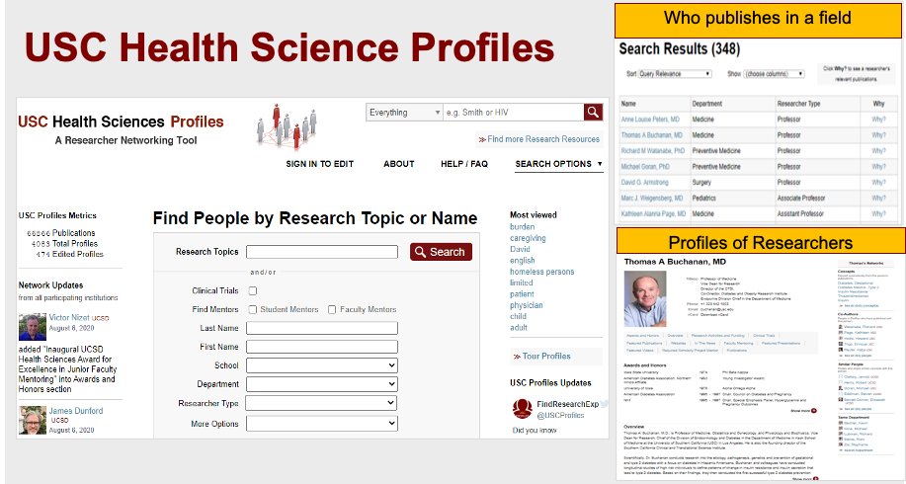

Slide 5
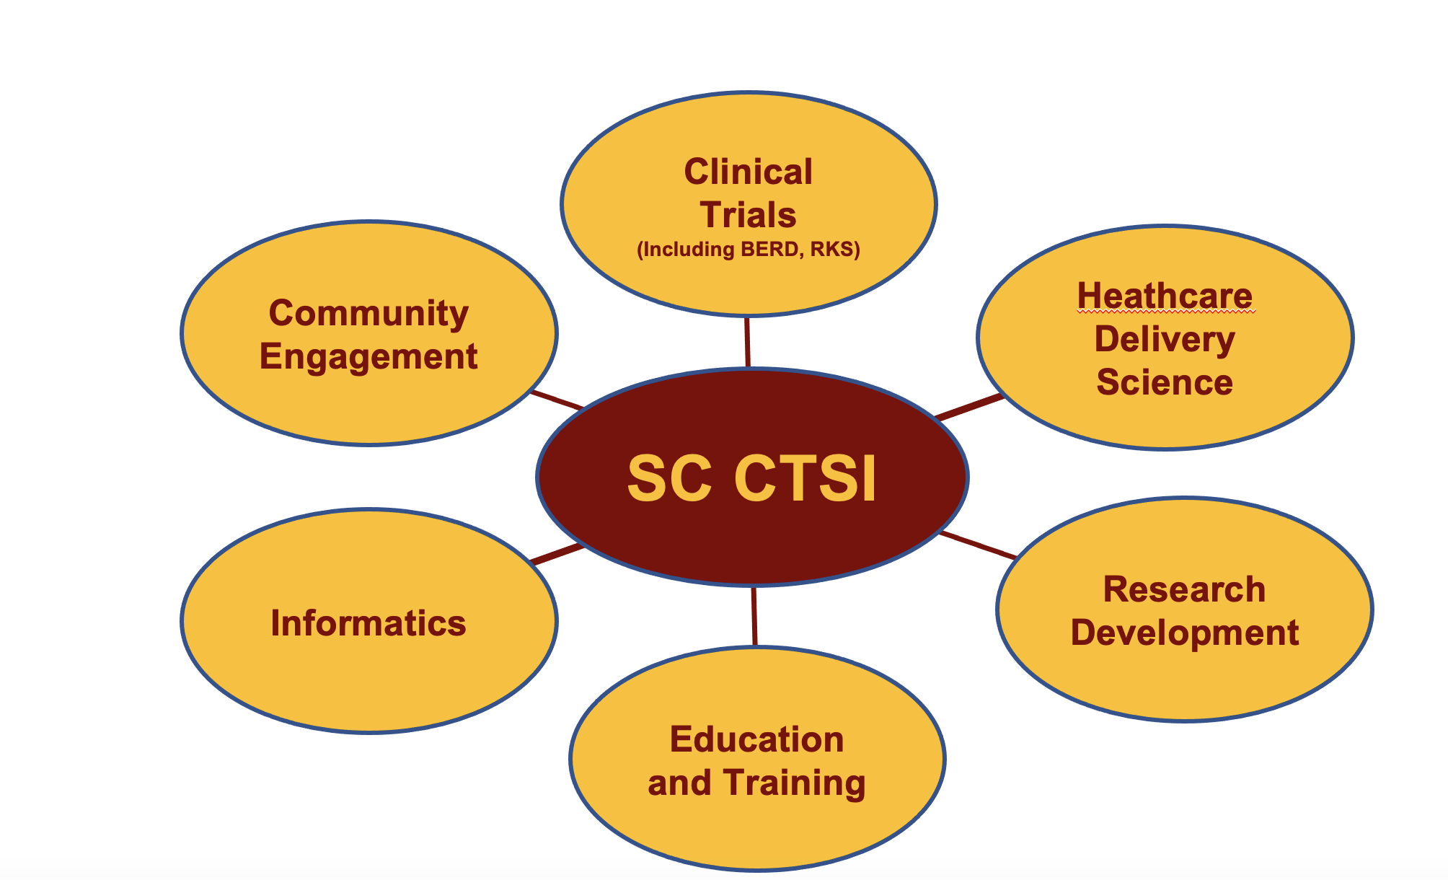

Slide 6
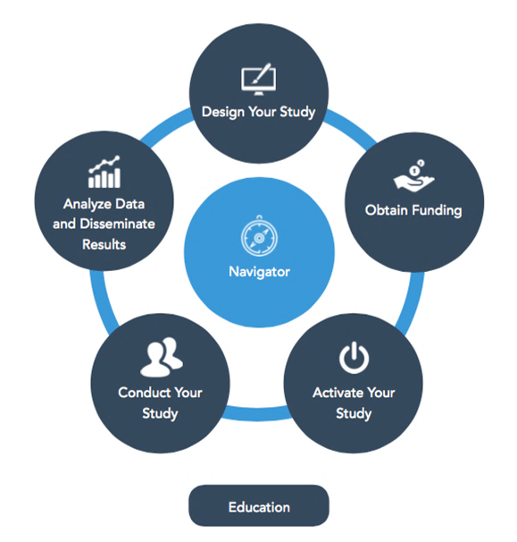
Research Services & Support
Study design and biostatistics (1st hr free)
Clinical research staff & lab services
Recruitment
Community-engaged research support
Clinical informatics research tools & services
Regulatory support
Healthcare delivery science education and support

Slide 7
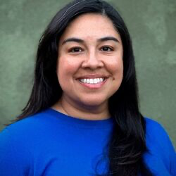
Clinical Research Staff
New Management
Clinical research coordinator (CRC) pool
Multiple levels of CRC experience depending on study needs
Multilingual and/or phlebotomy trained CRCs upon request
CRCs cleared to work in Keck facilities, LA General Medical Center, etc.
Ari Padilla, MBA
CRS Program Manager

Slide 8
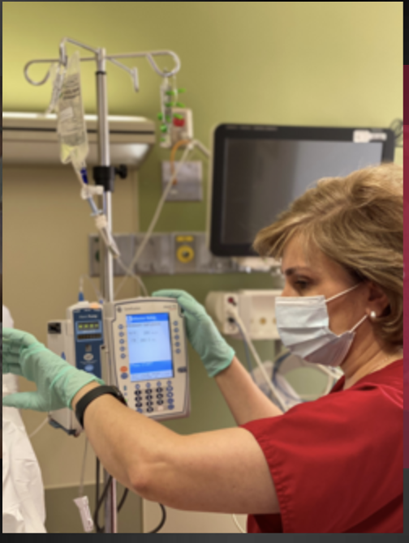
USC Clinical Trials Unit*
Provides a broad range of outpatient services for the conduct of human studies
  Specializing in medium to high complexity
Highly qualified research staff including skilled research nurses, research phlebotomists
Experienced research laboratory
CTU Specimen Processing Center
Located in Norris Comprehensive Cancer Center; serving all studies
*at USC & CHLA

Slide 9
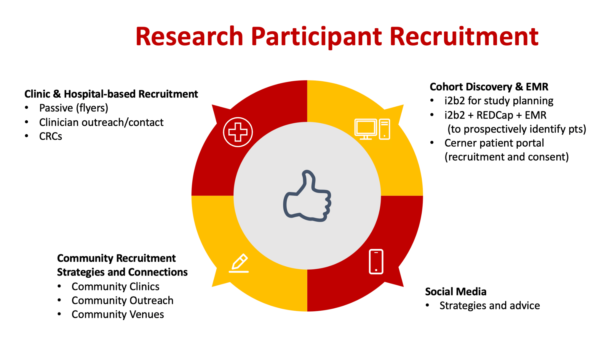

Slide 10
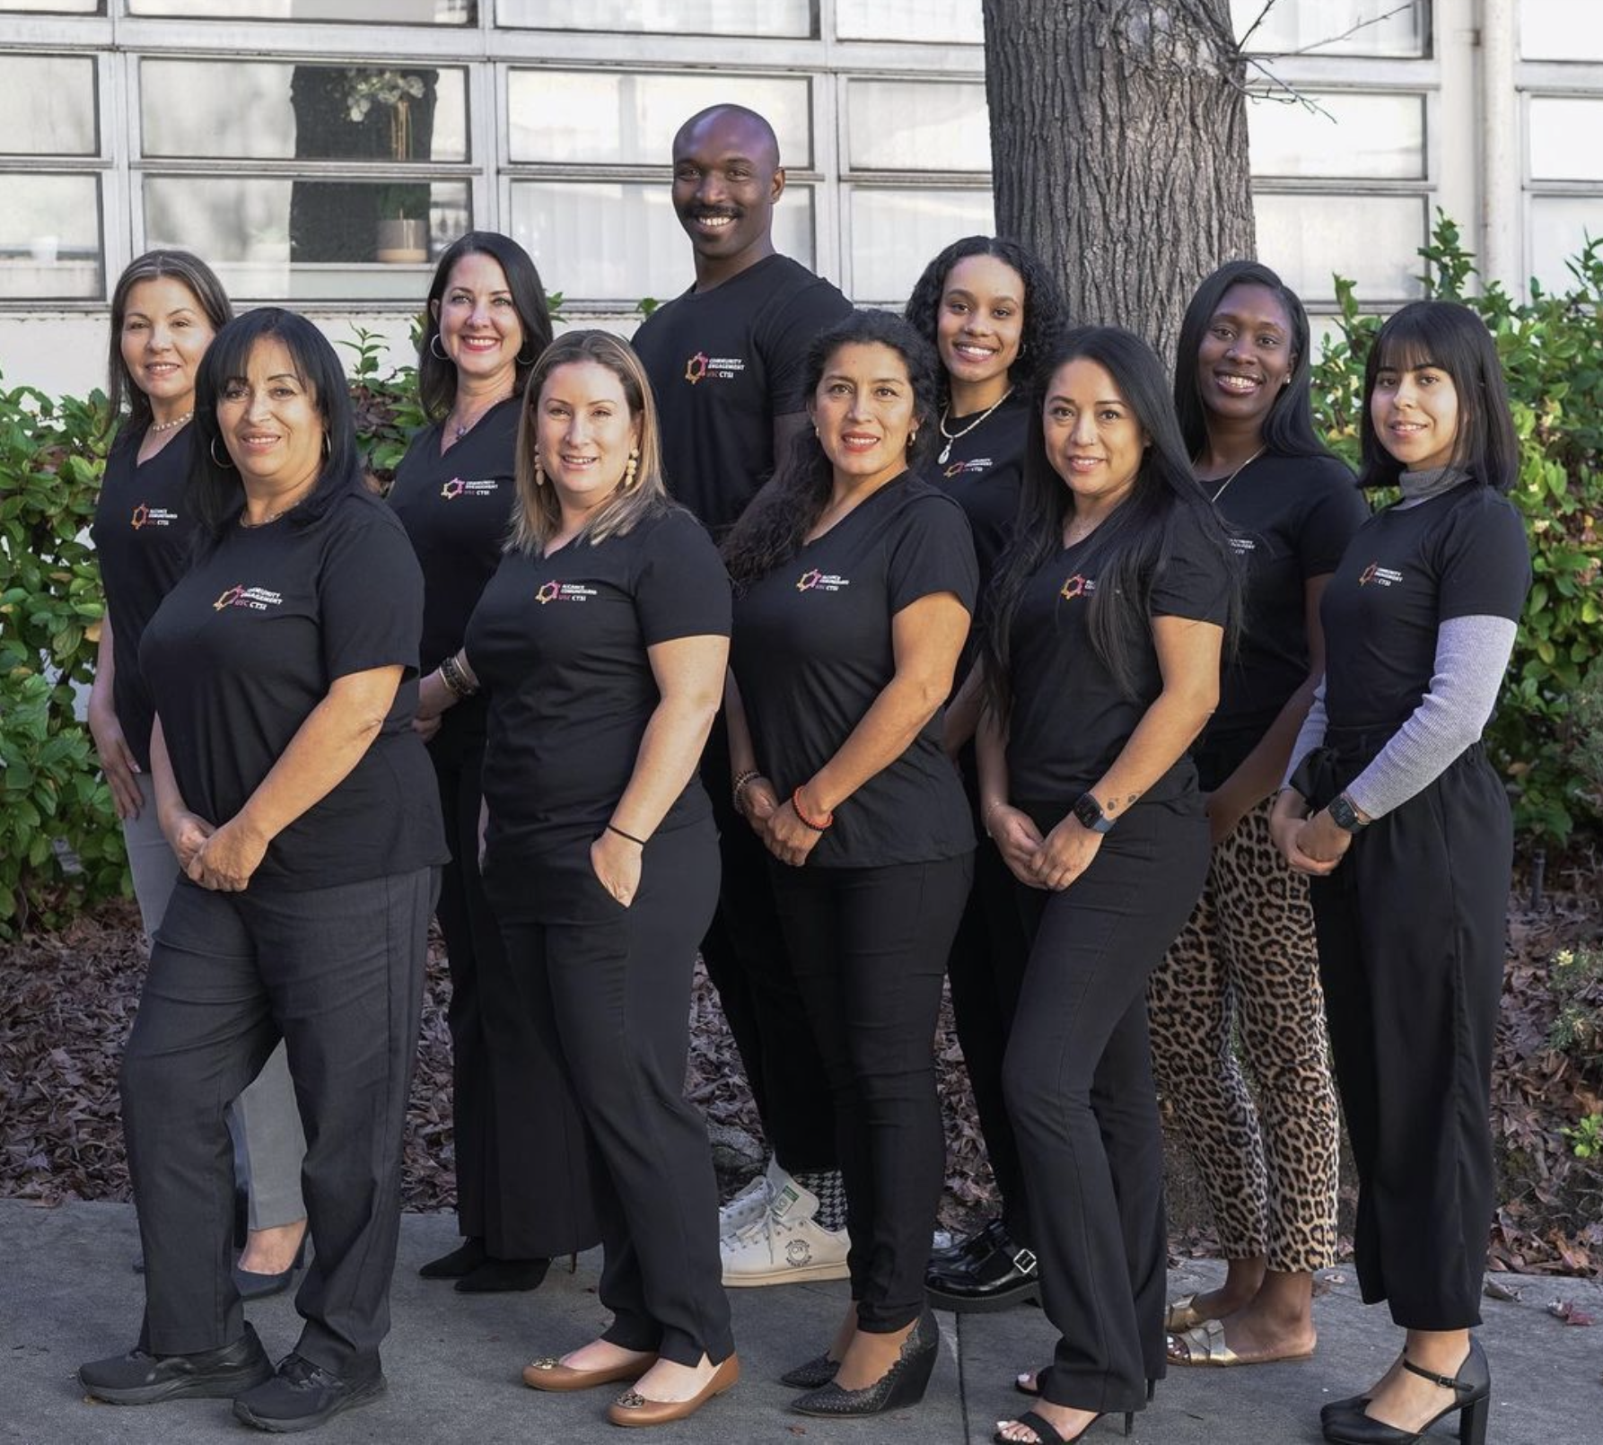
Community-Engaged Research Support
Help researchers develop strategies for bi-directional collaboration with community members and organizations
Research workshops, education, community outreach, community “listening sessions” to inform research questions and support community partnerships
Over 250 community partners (organizations, faith community, schools, health providers)
Community Engagement
Team

Slide 11
Informatics-Based Tools & Services
Free educational presentations for faculty members, researchers and their teams
EMR-based study feasibility & recruitment at Keck, LADHS, CHLA
Data capture and management tools & training (REDCap, MyCap)
Harmonizing data across multiple platforms
$150/hr recharge rate

Slide 12
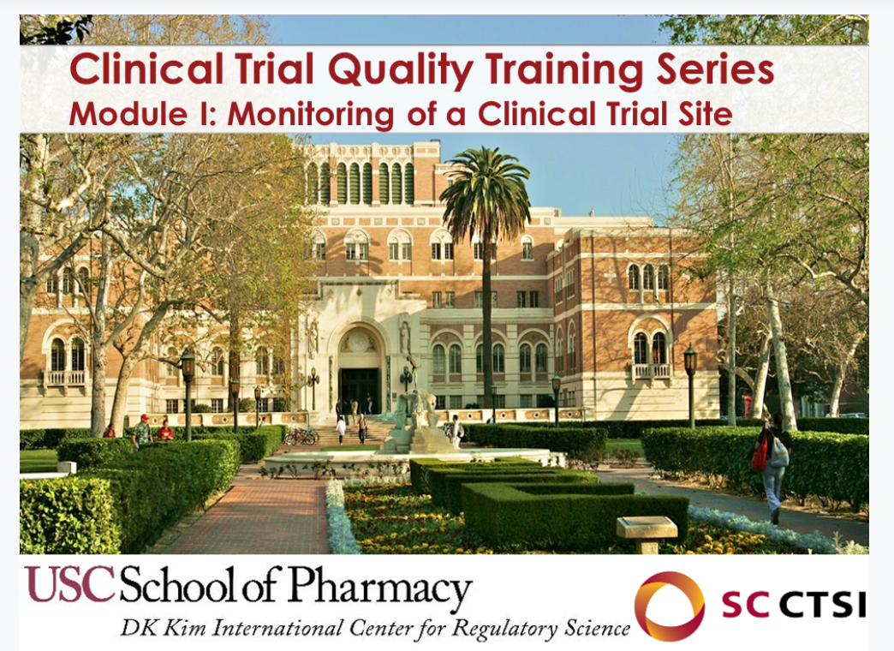
Regulatory Support
Free, high-quality training modules on monitoring, auditing, site visits
Educational library for clinical research professionals
Consulting services on FDA submissions
Symposia covering current regulatory topics each semester

Slide 13
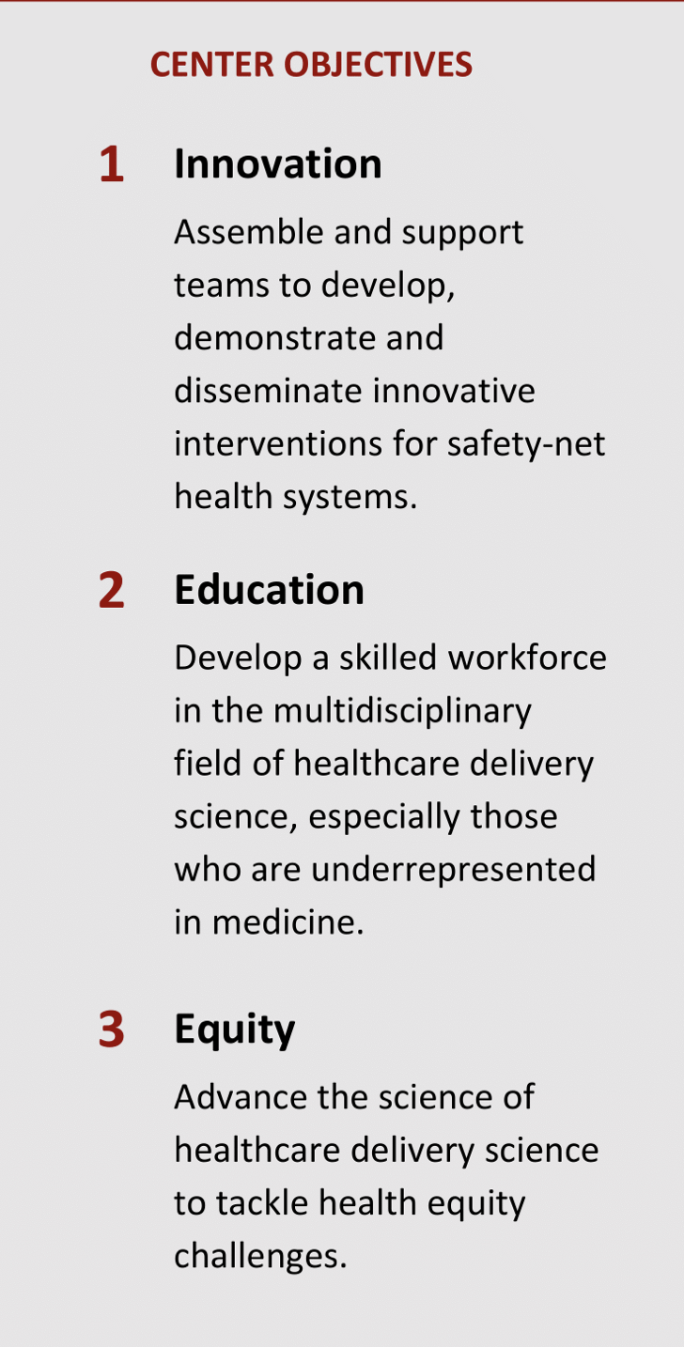
Healthcare Delivery Science Education & Support
Grant program with LACDHS
Consultations
Events (Annual symposium)
Education and Mentorship
  Online certificate course with 10 disciplines
  Academic and health system mentor teams

Slide 14


Education & Training
Click here to sign up for upcoming events!

Slide 15
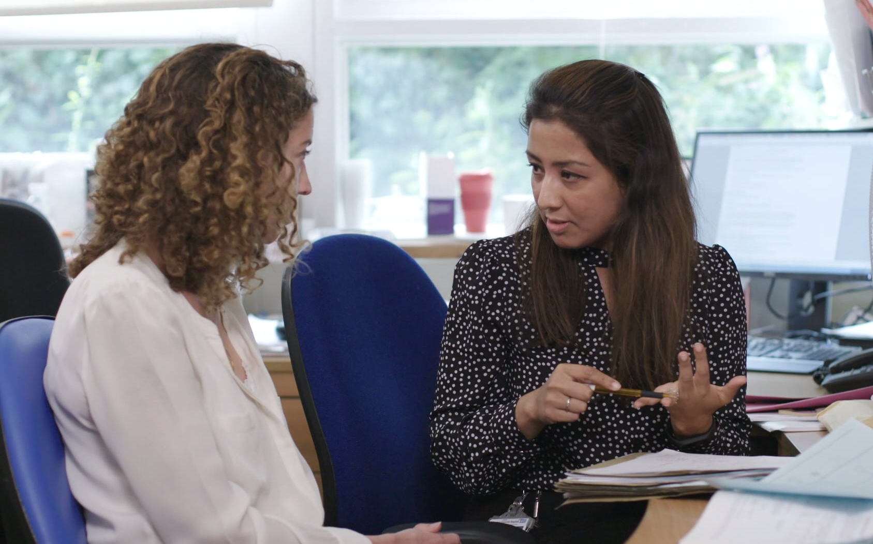

Mentored Career Development Award (KL2)
Applications due on August 31
by 5 p.m. PT
Three-year program for clinically trained junior faculty members:
Four scholars per year
MCTS, mentorship, quality by design, research project
Requires a minimum of 75% effort
Tuition/research/travel costs of up to $25K/yr

Slide 16
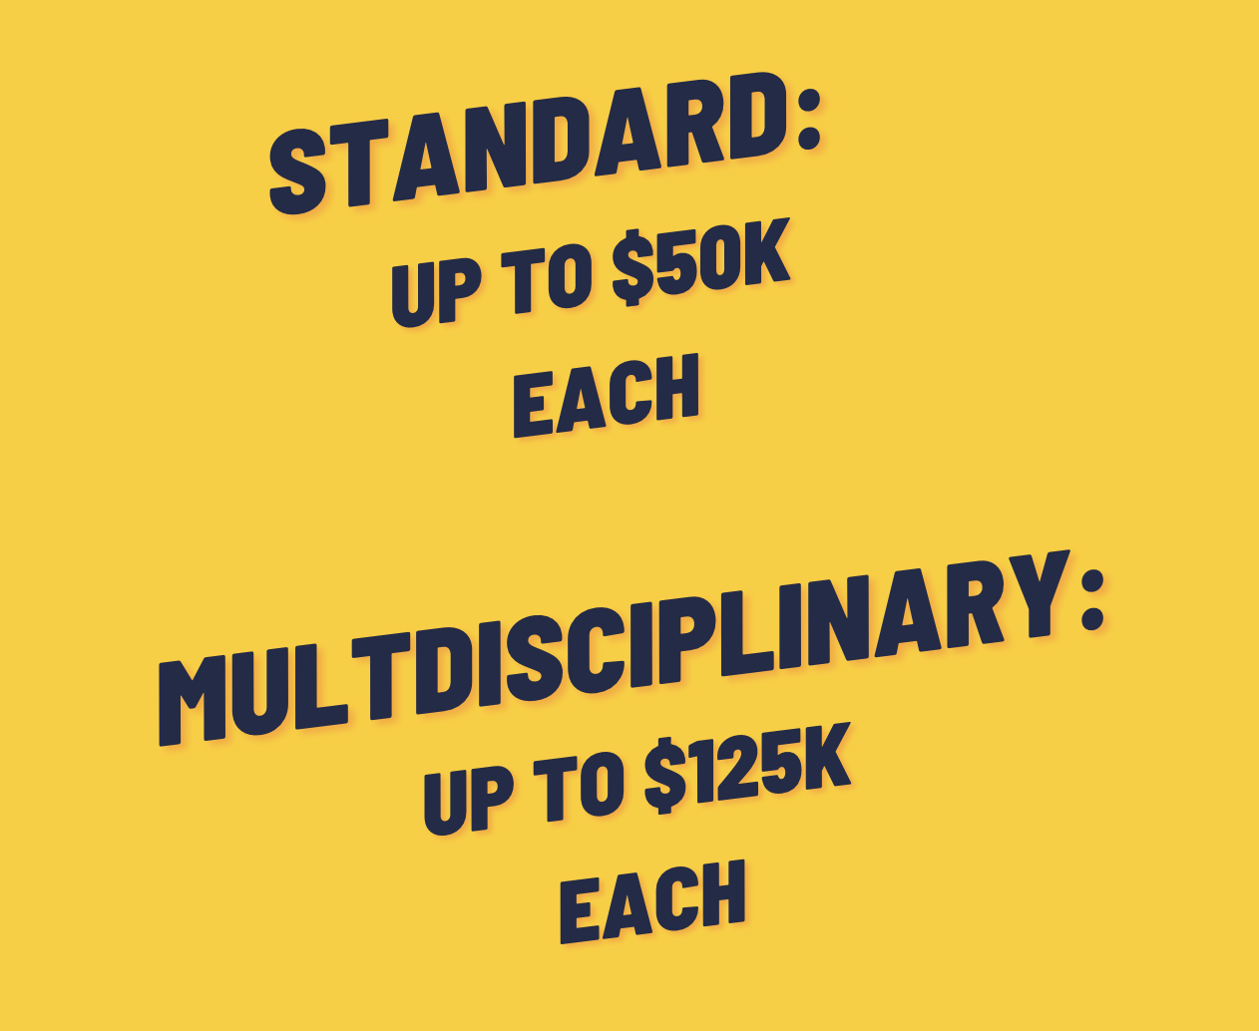


Funding Opportunities
Healthcare Delivery Science Safety Net Innovation Award
Pilot Program
Team Building Voucher
Two tracks:
Standard or Multidisciplinary
Clinical, community or health systems research
Multidisciplinary team building/science
Due November each year
Supports projects that develop, implement and/or evaluate interventions that are designated by DHS as high priority
Due September each year
Supports building new multidisciplinary teams to solve clinical/community research challenges
Due July & January each year

Slide 17



Questions? We’re happy to help.
323-442-CTSA
crs@sc-ctsi.org
Informational PDF about our services

