Slide 1
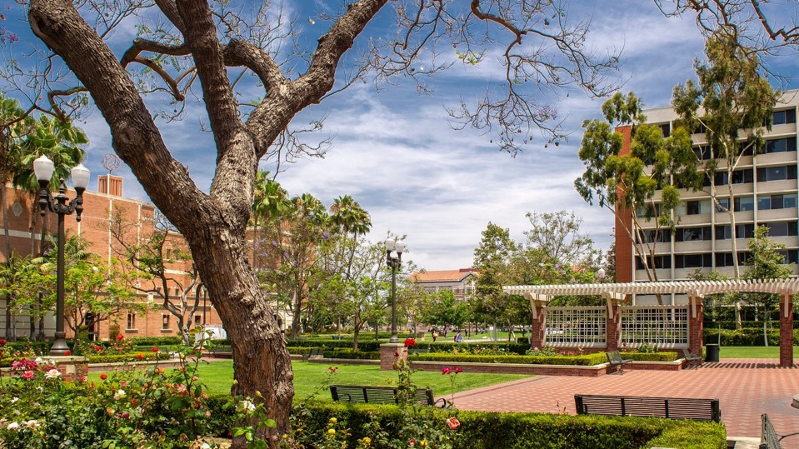

Research Support from Foundations for Arts and Humanities
Dana Irwin, Ph.D.
Associate Director, Corporate and Foundation Relations
9/27/22

Slide 2
What are foundations?
Foundations are charitable grantmaking organizations.
  Mission-driven
  Strategic
Thousands of foundations in the U.S.; ~$1B awarded to grantees in 2023
75% of foundation grants awarded to USC support the research enterprise.

Slide 3
Trends
⅓ of foundations increased their giving in 2020, but current economic headwinds could reverse those trends in the coming year
New foundations being formed every year
Single point of contact to help navigate a large university; few concurrent grant
Foundation grants are increasingly competitive
  Some 7 or 8-figure gifts or grants, but generally 6-figure
  Balancing support for research with implementation programs / initiatives
    In 2020, over 50% of grant $ went to programs serving the economically disadvantaged, youth and children
Funding for multi-disciplinary approaches to most challenging problems
  Include external partner(s)
  Clear articulation of impact; maximize “return on investment”
  Multi-university programs and grants

Slide 4
Organization Structure / Process
Foundation Relations is part of USC Advancement
  ~20 professionals
  5 Central and 16 in schools / units
  Primary point of contact for cultivation and solicitation
Coordination across USC: All foundations are assigned
  Centrally-managed: largest foundations with interests across the university
    Presidential Foundations: Direct engagement(s) with President Folt or university leadership
    Institutionally limited submissions
      Close coordination with with Office of Research
  School-managed: foundations with interests solely related to one school
Close collaboration with Department of Contracts and Grants (DCG)

Slide 5
Working with USC Foundation Relations
Coordination across USC is critical and a requirement for many foundations
  Salesforce database tracking all interactions, proposals and strategies
  Approximately 25 foundations are designated as “Presidential”
  Institutionally limited submissions
USC’s Foundation Relations Officers offer significant knowledge on the organizations they are assigned to
  Access to tools such as Foundation Directory Online
  Knowledge of best practices and approaches for greater success
    Connecting internal and external stakeholders and potential collaborators
  Cultivation of foundation leaders and program officers
  Assist faculty with preparation for meeting(s) with foundation prospect(s)
    Strategic positioning of Letter of Intent (LOI) and/or proposal(s)
  Engaging and leveraging university’s academic leaders when appropriate

Slide 6
What do USC Foundation Relations officers do?
We identify foundations with grantmaking programs that align with USC funding needs.
We build relationships with foundation board members and program officers.
We disseminate funding opportunity information.
We work with campus leadership and faculty on strategies tailored to the funder.
We help you develop compelling proposal submissions.
  Deep-dive proposal framing/writing/editing
  Answer questions about the foundation, submission process, etc.
  Budget development
  Auxiliary information
  Portal submission

Slide 7
Types of Foundations
Private foundations: funds come from an individual, a family, a corporation or some combination of related parties
  Mellon Foundation
  Ford Foundation
  Corporate Foundations such as Bank of America Charitable Trust, Google.org
Public foundations: funds come from multiple unrelated donors; may include individuals, private foundations as well as government grants
  Tend to be geographically focused
  Generally grants to grassroots organizations, social programs & community engagement initiatives
    California Community Foundation
    ClimateWorks Foundation

Slide 8
What types of funding opportunities do foundations offer?
Request for Proposals (RFP): Communicated to faculty and leadership via School-based bulletins and, where appropriate, directly by Foundation Relations
Limited submission: USC may submit a limited number of proposals
          Opportunities posted on the Office of Research website
      PI(s) selected by committee through an internal pre-proposal process
      Foundation Relations supports selected PI(s) and department chair(s)
Invitation to submit: Foundation Relations cultivates a relationship with the foundation that can lead to a proposal invitation.

Slide 9
Centrally Managed Arts and Humanities Foundations (Ex.)
Foundation | Program Area | Grant ($)
Mellon Foundation | Higher learning, Arts and Culture, Humanities in Place, Public Knowledge | $100k-$1million
Ford Foundation | Creativity and Free Expression; Gender, Racial and ethnic Justice | $100k-$1million
Carnegie Corporation | Fellowship Program (at both junior and senior level) | $100k-$500k
Luce Foundation | Program areas devoted to women in STEM, Asian culture and languages, Indigenous knowledge | $100k-$500k

Slide 10
Examples of recent grants to USC
Irei: National Monument for the WWII Japanese American Incarceration, Mellon Foundation, USC Shinso Ito Center for Japanese Religion and Culture, Duncan Williams (Dornsife), PI, 2021
Mellon Support for the Paul Revere Williams Archive, USC Architecture, 2024
Carnegie Junior Fellow, Hajar Yazdiha, Sociology, Dornsife (2024)
Emily Ryo, Gould (2017)
“Missing and Maligned: Exploring Muslim Representation in Media,” Ford Foundation, Stacy Smith (Annenberg), PI
“Transpacific Studies: Building the Foundations of an Undisciplined Field of Inquiry,” Luce Foundation, Janet Hoskins (Dornsife), PI
Most recent Guggenheim Fellows: Lisa Pon (Dornsife) and Nina Young (Thornton)

Slide 11
Other funding sources for Arts and Humanities
Government Agencies (handled through the Office of Research):
  National Endowment for the Arts
  National Endowment for the Humanities
Local Foundations that may support arts activity in the community
  Some require partnership with a local non-profit to apply
  Will require demonstration of impact on community through a series of metrics
Individual arts and humanities fellowships from a large foundation such as John Simon Guggenheim Foundation
When applying, ensure coordination with your school’s budget office and development staff.

Slide 12
FAQs
When should I contact Foundation Relations?
When you have a question, anticipate submitting a proposal, need help with a proposal, or receive a grant.
Can I contact a foundation directly about supporting my work?
Please contact Foundation Relations before initiating contact with a foundation.
What should I do if a foundation contacts me?
Please alert us right away. We will help you navigate USC's internal process and assist with the development of your submission.
I received an agreement that needs a signature(s). What do I do?
Let us know! We will handle the review process for you to obtain the appropriate signature(s).

Slide 13
Summary
Foundations represents an important source of funds for USC research, programs, and initiatives.
USC Foundation Relations officers working with colleagues in Office of Research and DCG are well positioned to help faculty and researchers to submit proposals
Our team will work to identify candidates for prestigious prizes and consulting with faculty leadership in schools to provide feedback about assessment of faculty for research fellowships.
Foundations have become much more selective in their grantmaking to higher education
  Increased need to coordinate our activities and outreach
For more information:
Dana Irwin, Ph.D., Director of Foundation Relations, University Advancement
danairwi@usc.edu

